Slide 1
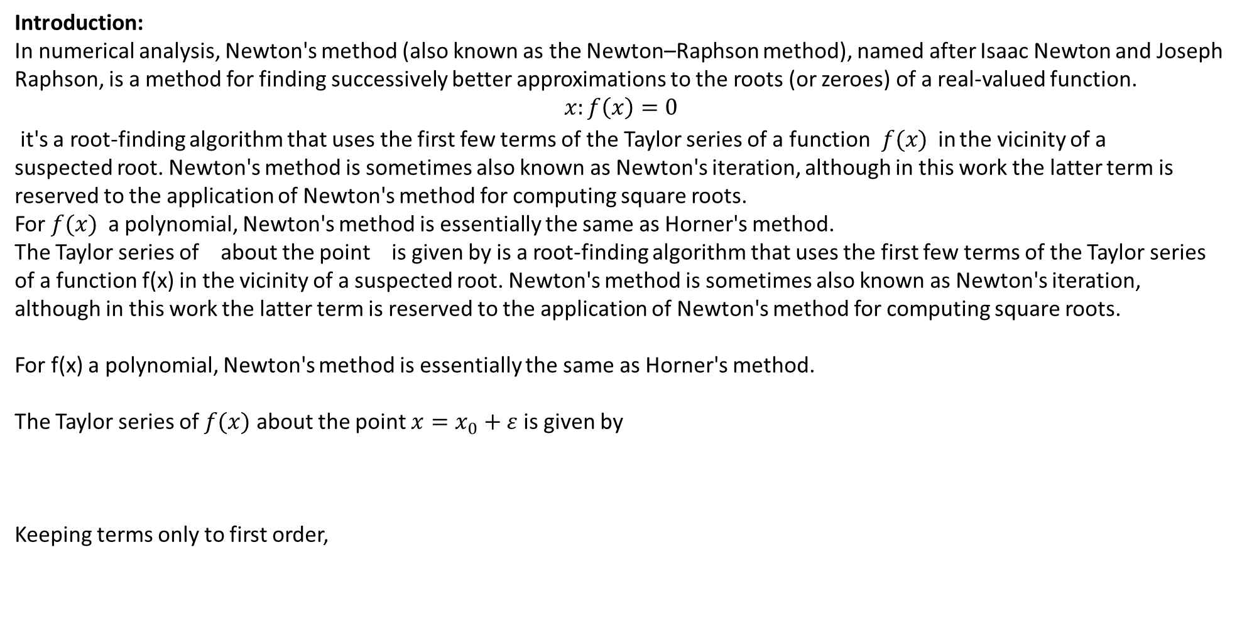
Introduction:
In numerical analysis, Newton's method (also known as the Newton–Raphson method), named after Isaac Newton and Joseph Raphson, is a method for finding successively better approximations to the roots (or zeroes) of a real-valued function.
$$x:f\left(x\right)=0$$
it's a root-finding algorithm that uses the first few terms of the Taylor series of a function$f(x)$in the vicinity of a suspected root. Newton's method is sometimes also known as Newton's iteration, although in this work the latter term is reserved to the application of Newton's method for computing square roots.
For $f(x)$ a polynomial, Newton's method is essentially the same as Horner's method.
The Taylor series of about the point is given by is a root-finding algorithm that uses the first few terms of the Taylor series of a function f(x) in the vicinity of a suspected root. Newton's method is sometimes also known as Newton's iteration, although in this work the latter term is reserved to the application of Newton's method for computing square roots.
For f(x) a polynomial, Newton's method is essentially the same as Horner's method.
The Taylor series of $f(x)$ about the point $x=x_{0}+ε$is given by
Keeping terms only to first order,

Slide 2
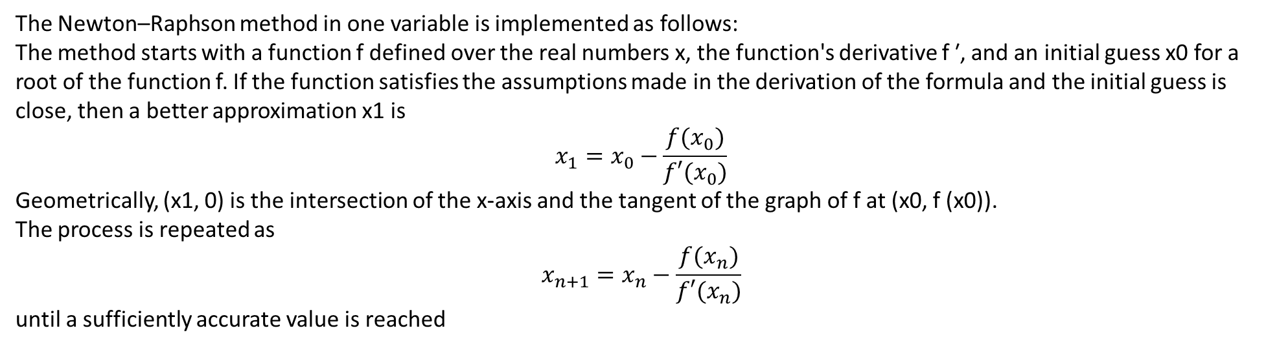
The Newton–Raphson method in one variable is implemented as follows:
The method starts with a function f defined over the real numbers x, the function's derivative f ′, and an initial guess x0 for a root of the function f. If the function satisfies the assumptions made in the derivation of the formula and the initial guess is close, then a better approximation x1 is
$$x_{1}=x_{0}−\frac{f(x_{0})}{f′(x_{0})}$$
Geometrically, (x1, 0) is the intersection of the x-axis and the tangent of the graph of f at (x0, f (x0)).
The process is repeated as
$$x_{n+1}=x_{n}−\frac{f(x_{n})}{f′(x_{n})}$$
until a sufficiently accurate value is reached
The function f is shown in blue and the tangent line is in red. We see that x_{n + 1} is a better approximation than x_{n} for the root x of the function f.

Slide 3
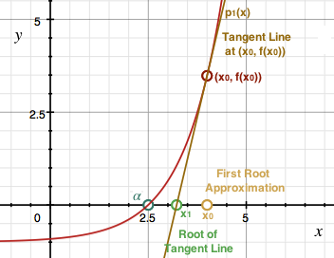
Suppose that y=f(x), and let α be a root of f, and suppose that x0 is a first approximation of the root α of f. Now consider the tangent line to the graph of f at the point (x0,f(x0)). Provided that this tangent line does not have slope 0, then this tangent line will have a root of its own that will approximately be equal to α.
The equation of this tangent line can be given by the following equation:
(1)
p1(x)=f(x0)+f′(x0)(x−x0)
If we set p1(x)=0 and solve for x1 as the x-intercept of the tangent line p1(x), then we obtain:
(2)
p1(x)=f(x0)+f′(x0)(x−x0)0=f(x0)+f′(x0)(x1−x0)x1=x0−f(x0)f′(x0)

Slide 4
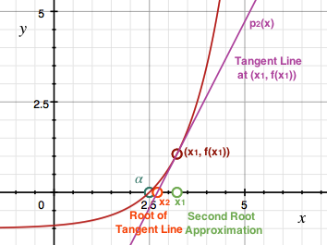
We now take x1 (the root of the first tangent line) to be an approximation of α. If we now look at the tangent line at (x1,f(x1)) on f, then we obtain a new tangent line, and provided that the slope of this tangent line is not 0, then this tangent line has a root of its own that is an even better approximation of α.
The equation of this tangent line can be given by the following equation:
(3)
p2(x)=f(x1)+f′(x1)(x−x1)
Once again, if we set p1(x)=0 and solve for x2 as the x-intercept of the tangent line p2(x), then we obtain:
(4)
x2=x1−f(x1)f′(x1)
In fact, the more we repeat this procedure, the closer and closer our approximation gets to α. For n+1 iterations of this procedure and provided that f′(xi)≠0 for i=1,2,...,n, we obtain the following general formula for the x-intercepts of the corresponding tangent lines as approximations to α:
(5)
xn+1=xn−f(xn)f′(xn)
One advantage of Newton's Method is that the sequence of approximations {xn} tend to converge much more quickly towards the root α. The major disadvantage of Newton's Method is that the sequence of approximations {xn} may not converge to α if we do not choose an initial approximation x0 that is sufficiently close to α.

Slide 5
if f is a differentiable function that contains the root α, and x0 is an approximation of α, then we can obtain a sequence of approximations {xn+1}={xn+1=xn−f(xn)f′(xn)} for n≥0 that may or may not converge to α. If our initial approximation x0 is too far away from α, then this sequence may not converge to α. We will now look at what must hold so that the error between our approximations xn and α converge to 0 so that {xn} converges to α.
Consider the interval [a,b] and suppose that there exists a root α∈(a,b) (f(α)=0). Assume that both f′ and f′′ are continuous functions and that f′(α)≠0 (that is the slope of the tangent line at (α,f(α)) is not 0 and hence is not a horizontal line). Using Taylor's Theorem we have that for some cnbetween α and xn that:
(1)
f(α)=f(xn)+(α−xn)f′(xn)+(α−xn)22f′′(cn)0=f(xn)+(α−xn)f′(xn)+(α−xn)22f′′(cn)
If we divide both sides of the equation by f′(xn) we get that:
(2)
0=f(xn)f′(xn)+(α−xn)+(α−xn)22f′′(cn)f′(xn)
Now since xn+1=xn−f(xn)f′(xn) then by rearranging these terms we get that f(xn)f′(xn)=xn−xn+1, and substituting this into the equation above and isolating for α−xn+1 we get:
(3)
0=(xn−xn+1)+(α−xn)+(α−xn)22f′′(cn)f′(xn)α−xn+1=−(α−xn)22f′′(cn)f′(xn)Error(xn+1)=−(α−xn)22f′′(cn)f′(xn)
Note that in the above equation for the error in the approximation xn+1 of α, that Error(xn)=α−xn appears. We can see that if the initial approximations are very small, then Newton's Method converges very quickly towards α upon successive iterations.
Now suppose that xn is very close to the root α. Then since cn is between xn and α then cn is also very close to α and hence:
(4)
−f′′(cn)2f′(xn)≈−f′′(α)2f′(α)=Mα
Therefore, for n≥0 we can approximate the error of xn+1 from α as:
(5)
Error(xn+1)=α−xn+1≈Mα(α−xn)2
We will now multiply both sides of the equation above by Mα to get that:
(6)
Mα(α−xn+1)≈M2α(α−xn)2=(Mα(α−xn))2
Now note that Mα(α−xn)≈M2α(α−xn−1)=(Mα(α−xn−1))2. If we repeat this process then we get that for n≥0:
(7)
Mα(α−xn)≈(Mα(α−x0))2n
Now for the error α−xn to converge to 0 (once again, so that our approximations xn converge to α), we must have that −1<Mα(α−x0)<1, i.e, ∣Mα(α−x0)∣<1, because if so, then as n→∞ we have that Mα(α−xn)→0.
(8)
∣α−x0∣<1∣Mα∣=∣∣∣2f′(α)f′′(α)∣∣∣
One important thing to note is that if we maximize Mα on the interval [a,b], that is let M be defined to be the largest possible Mα over [a,b], then for any Mα we have that:
(9)
∣Mα∣=∣∣∣−f′′(α)2f′(α)∣∣∣≤maxa≤x≤b∣∣∣f′′(x)2f′(x)∣∣∣≤maxa≤x≤b∣f′′(x)∣2mina≤x≤b∣f′(x)∣=M
If we have that M<1, then all Mα<1 which will guarantee us convergence of Newton's Method to α.

